Slide 1



Analyzing the Stock Market:
The Dividend Aristocrats
By: Bryan Pritsker

Slide 2


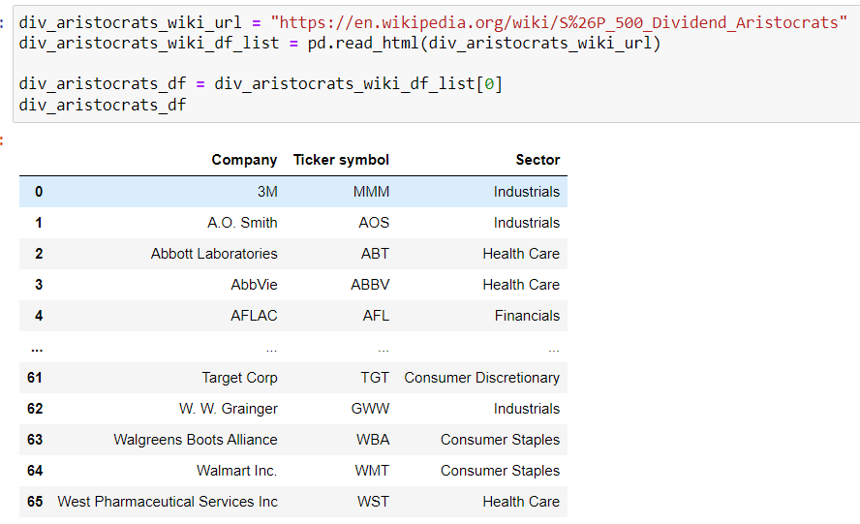
What is a
Dividend Aristocrat?
A company is classified as a dividend aristocrat if it increases the dividend it pays to shareholders for at least 25 straight years.
A dividend aristocrat must be a member of the S&P 500.
Dividend Aristocrats tend to be large, established companies that provide consistent returns to their shareholders.

Slide 3
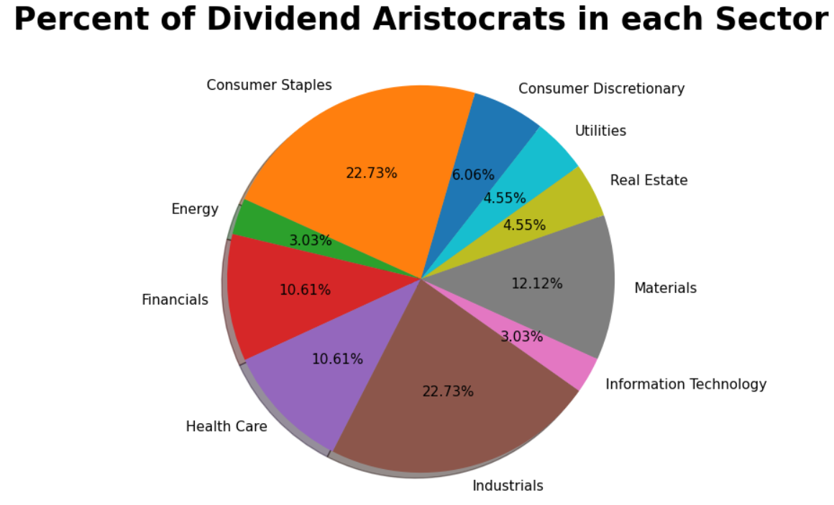

There are 66 Dividend Aristocrats as of 07/08/23.
They vary across many different industries in the economy:

Slide 4


Hypothesis
The best performing Dividend Aristocrat stocks:
Will come from either the Consumer Staples or the Health Services Industries
Have a dividend yield between 2-3%.
Have an annual dividend growth rate of at least 7%.
Have an average increase in Gross Profit be at least 10%
Have an average annual increase in Total Revenue be 10%.

Slide 5


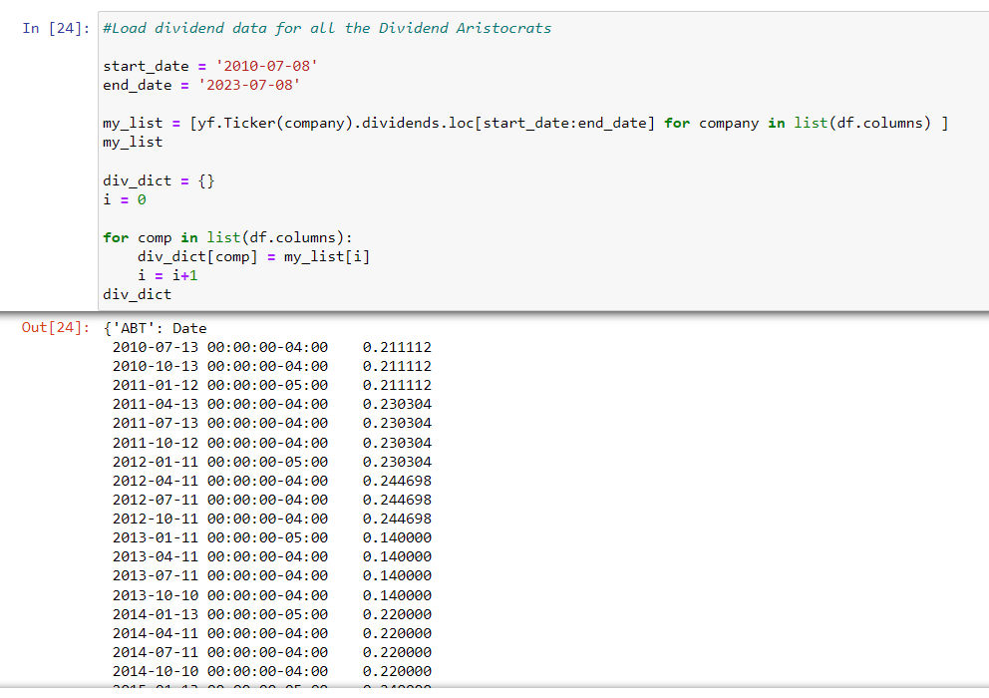
Gathering Information
To properly analyze the Dividend Aristocrats, I used the “yfinance API”.
yfinance helped me download fundamental data on each of the companies .
I then sliced through this data to get the stock prices for each of the 66 Dividend Aristocrats.
In one dataframe, I stored the closing stock prices for each company ranging from the dates: 07/08/2010 - 07/08/2023.
Then in a separate python “dictionary”, I downloaded and stored the dividend payments and the dividend dates for each company.

Slide 6
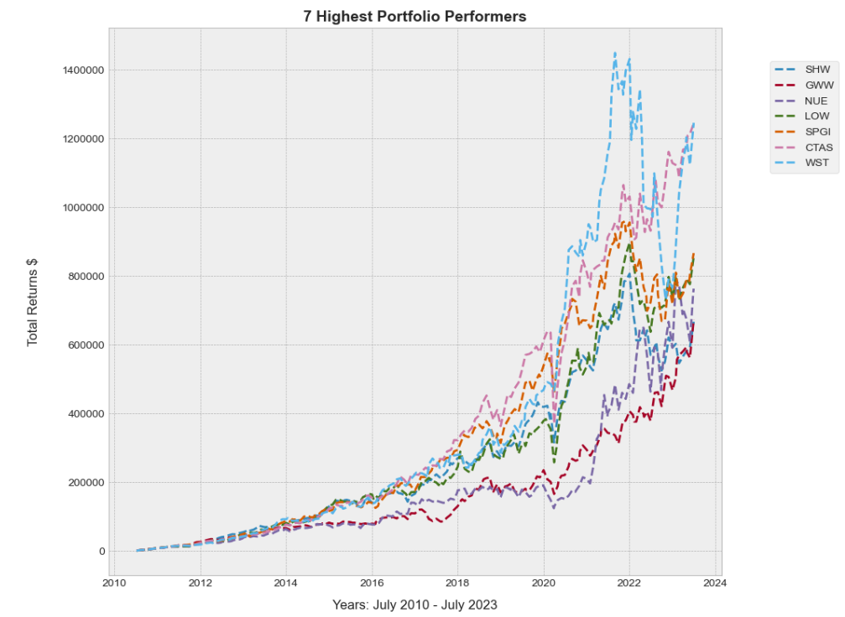


Results of BEST Performing Stocks
If you would have invested $1000 every month from
07/08/2010 - 07/08/2023:
Out of the 66 Dividend Aristocrats: WST, CTAS, SPGI, LOW, NUE, GWW, and SHW would provide you the greatest total return (assuming dividend reinvestment)!
WST (West Pharmaceutical Services Inc.) and CTAS (Cintas Corporation both had total returns exceeding $1,000,000!

Slide 7
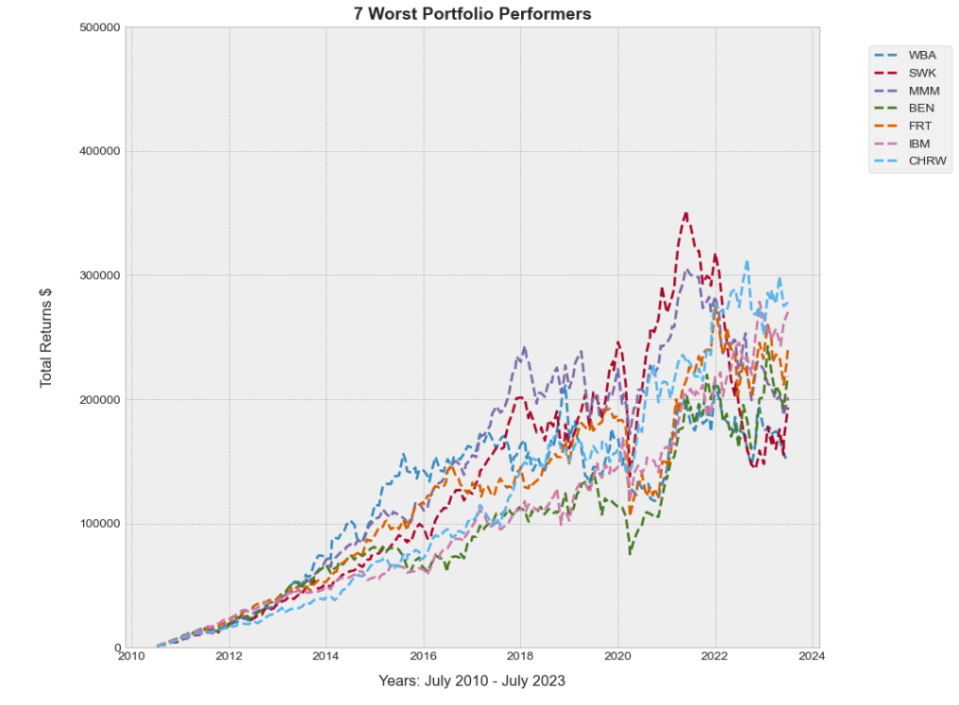


Results of WORST Performing Stocks
If you would have invested $1000 every month from
07/08/2010 - 07/08/2023:
WBA, SWK, MMM, BEN, FRT, IBM, and CHRW would provide you with the worst total return (assuming dividend reinvestment)!
The average return of these 7 stocks is: $221, 880

Slide 8
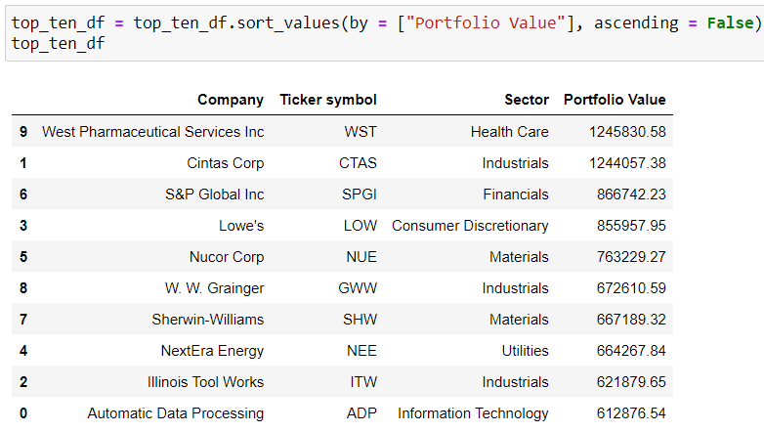
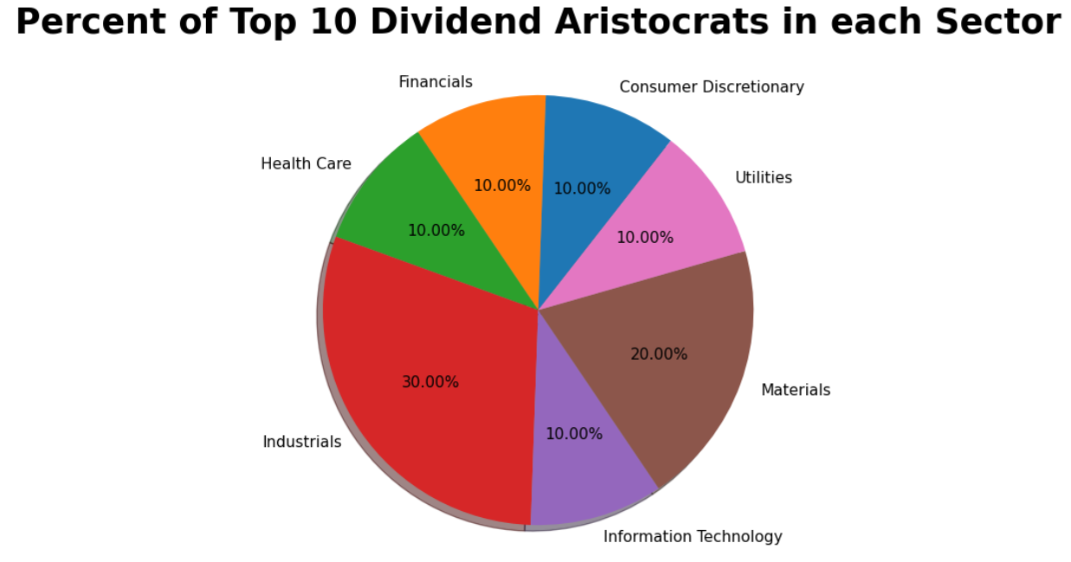
Top 10
Stocks by Sector
3 out of the top 10 total portfolio value stocks are in the “Industrials” sector
2 out of the top 10 total portfolio value stocks are in the “Materials” sector
None of the top 10 stocks are in the “Energy”, “Real Estate”, and “Consumer Staples” sectors

Slide 9
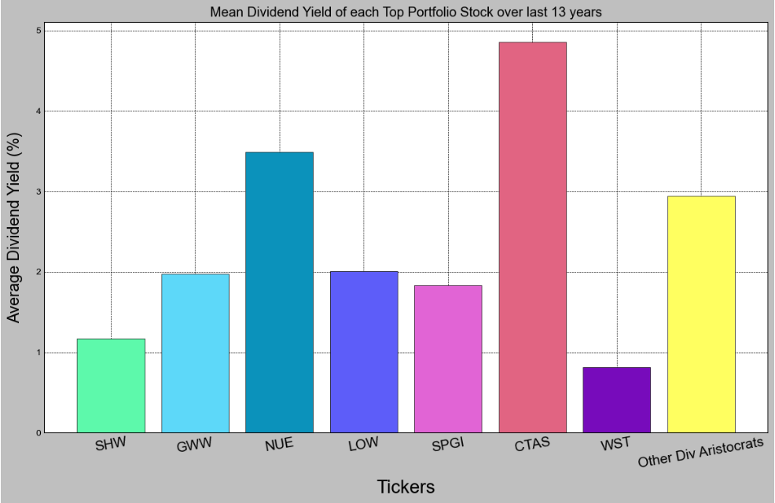
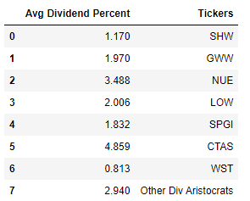
Analyzing Dividend Yields: Part 1
Between
07/08/2010- 07/08/2023
CTAS had the highest average dividend yield at 4.859%
The rest of the 59 Dividend Aristocrats had the third highest average yield at 2.94%.

Slide 10
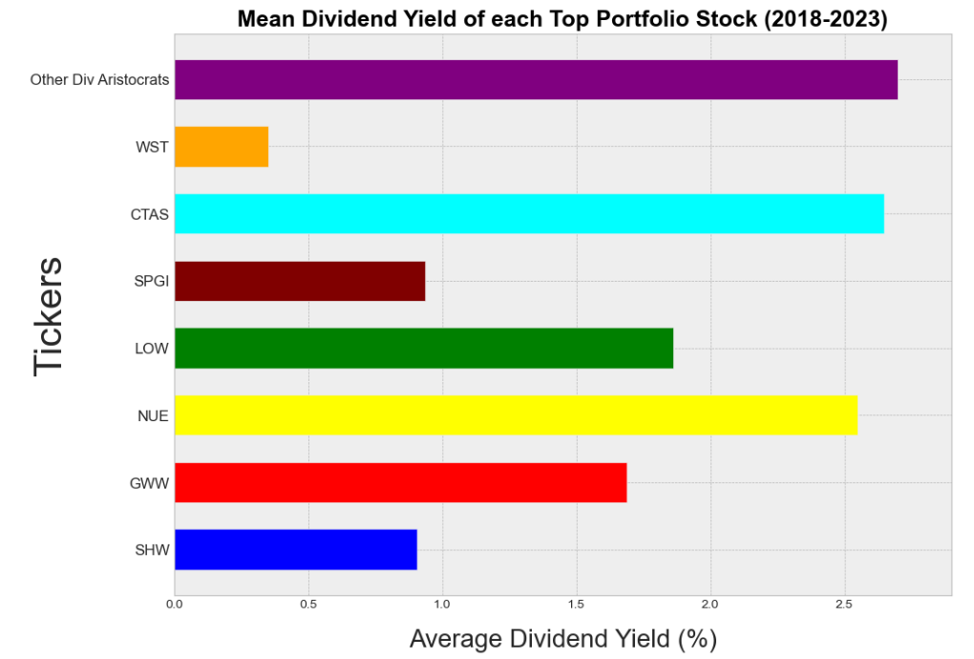
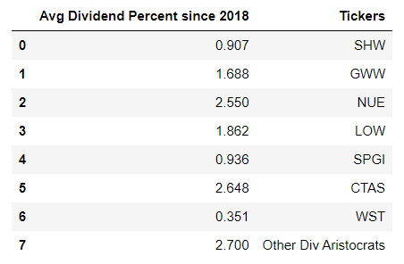
Analyzing Dividend Yields: Part 2
Between
07/08/2018- 07/08/2023
The other 59 Dividend Aristocrats had the highest 5 year average dividend yield at 2.7%!
5/7 of the top performing Dividend Aristocrats had a mean 5 year dividend yield of less than 2%.

Slide 11
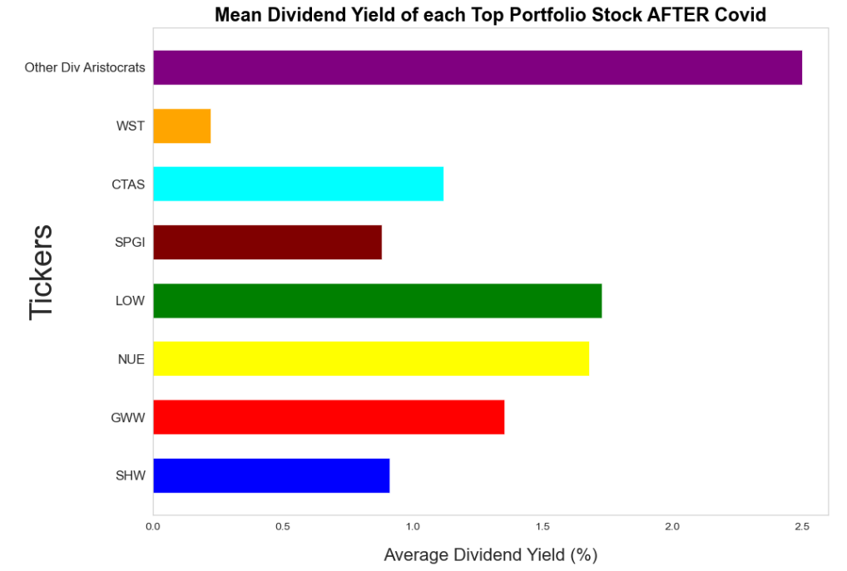
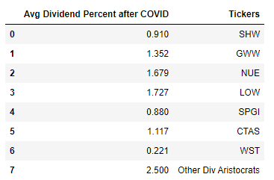
Analyzing Dividend Yields: Part 3
Between
01/01/2021- 07/08/2023
The other 59 Dividend Aristocrats had by FAR the highest average dividend yield at 2.5%!
None of the top performing Dividend Aristocrats had an average dividend yield of 2% or more.

Slide 12


Remarks:
Over the entire 13 year span, all Dividend Aristocrats, whether the top performers or the other companies, had relatively similar dividend yields.
However, as the top performers began to grow significantly in price, their dividend yields began to inversely fall.
From the year 2018 to 2023, the top Dividend Aristocrats had substantially smaller yields compared to the average of their peers.
This became even more apparent after COVID from 2021-2023.

Slide 13
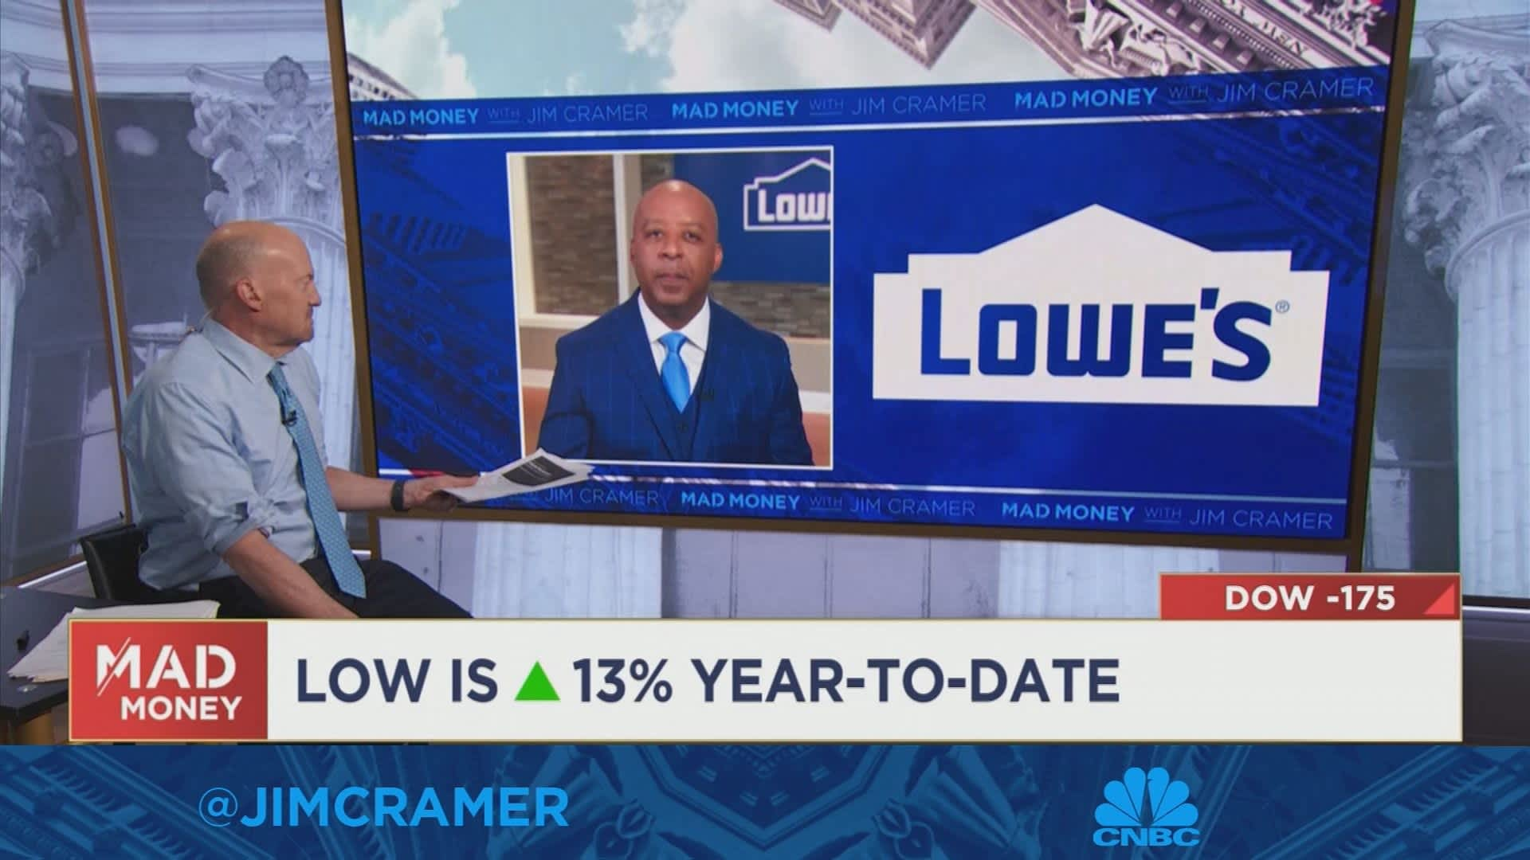
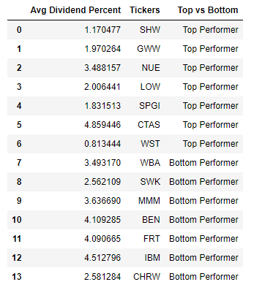
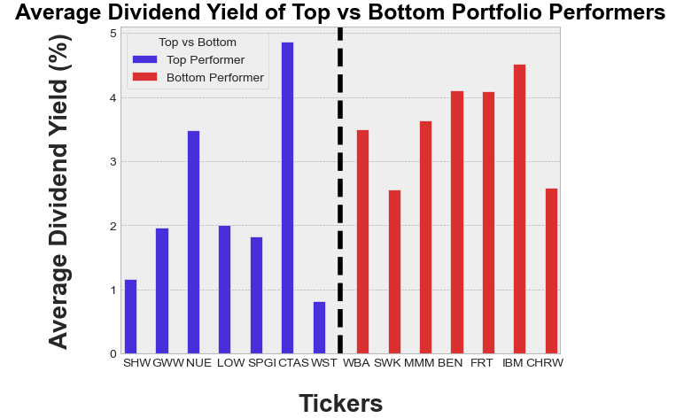
Avg. Dividend Yield: 2010-2023

Slide 14
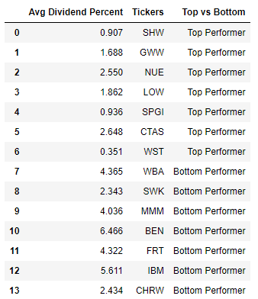
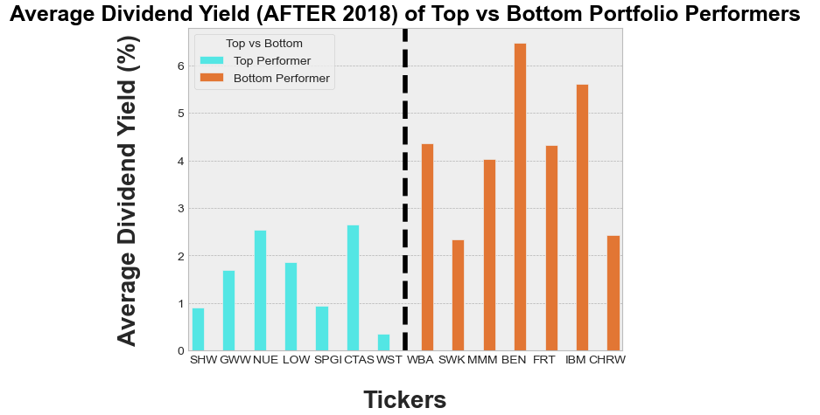
Avg. Dividend Yield: 2018-2023

Slide 15
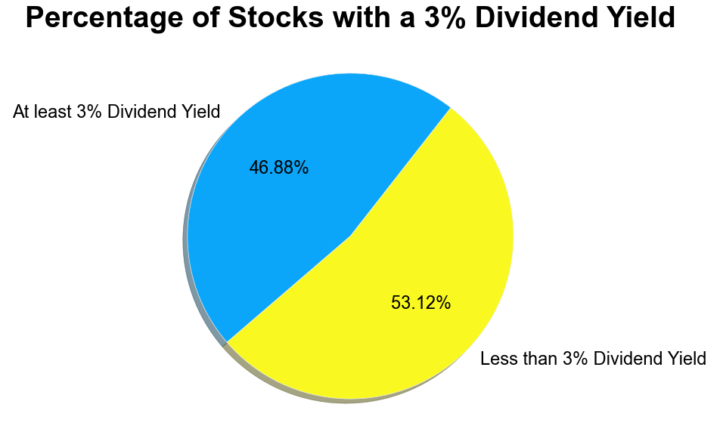
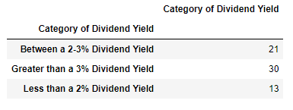
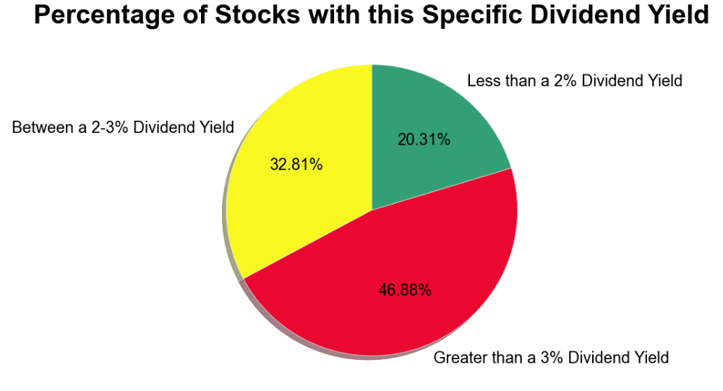
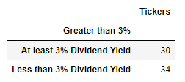
Dividend Yield Categories

Slide 16
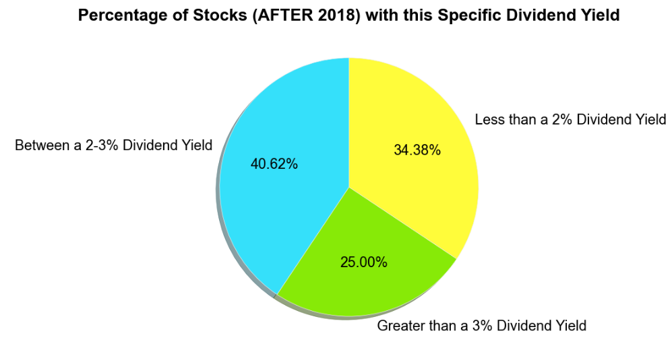
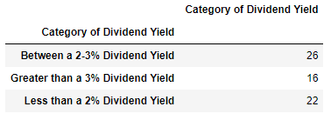
Dividend Yield Categories After (2018)

Slide 17

Remarks on Dividend Yield Categories
Over the 13 year span, the majority of Dividend Aristocrats paid an average Dividend Yield of greater than 3%.
However, as the prices of certain companies increased, the number of Dividend Aristocrats that continued to pay an average of a 3% dividend yield decreased significantly.
Thus, higher dividend yields do NOT necessarily correlate with larger price gains!

Slide 18
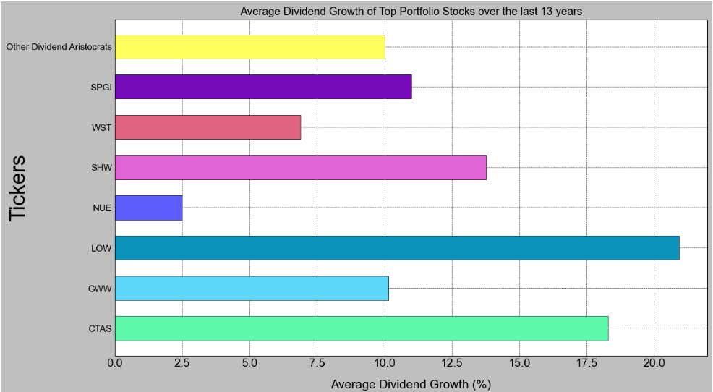
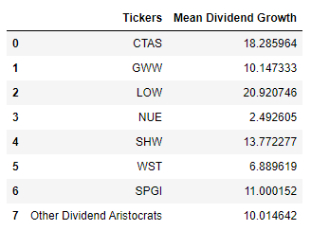
Analyzing Dividend Growth: Part 1
(07/08/2010 - 07/08/2023)
5/7 of the top Dividend Aristocrat stocks had a larger annual dividend growth rate than the rest of the Dividend Aristocrats.

Slide 19
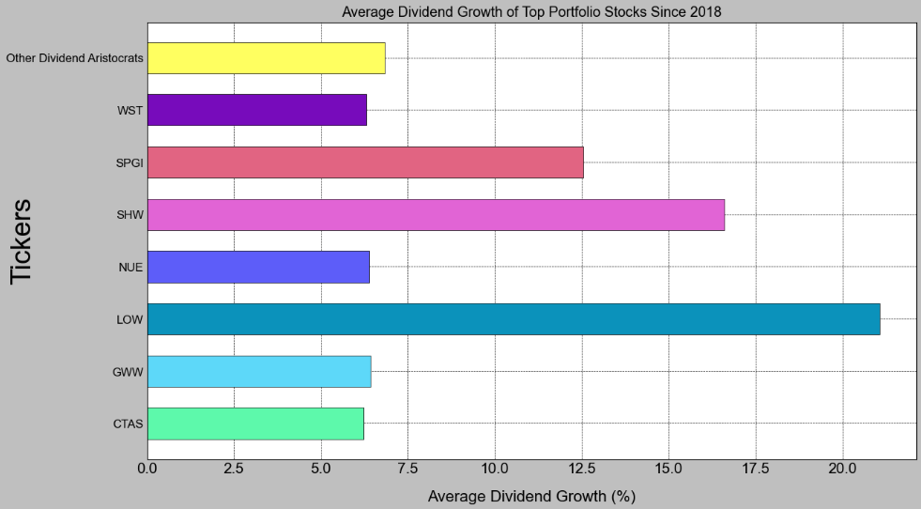
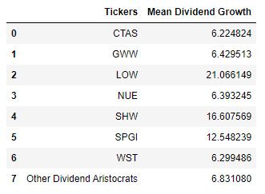
Analyzing Dividend Growth: Part 2
(07/08/2018 - 07/08/2023)
Companies like Lowe’s (LOW), Sherwin-Williams (SHW), and S&P Global Inc (SPGI) had massive annual dividend increases between (2018-2023).

Slide 20

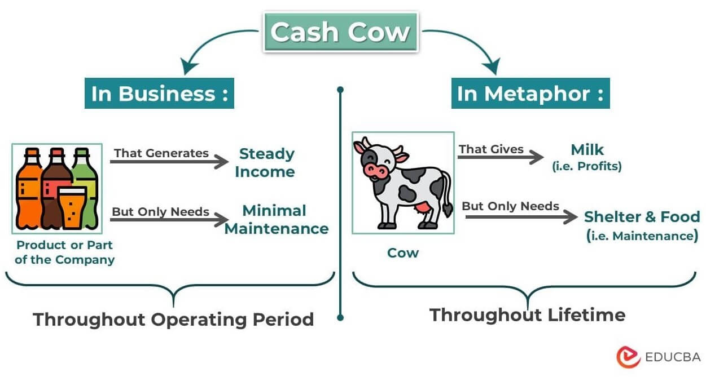
Remarks on Dividend Growth:
When considering the 13 dividend growth chart: the top Dividend Aristocrat stocks tend to produce both high and consistent dividend growth rates year after year.
These stocks are major cash cows that are not heavily swayed by economic disruptions or cyclical fluctuations.
The 5 year dividend growth chart emphasizes these claims-> even through a turbulent time such as Covid, the top dividend aristocrat stocks continued to pay massive dividend increases over this time period.
Moreover, the majority of Dividend Aristocrats were able to produce average dividend growth rate of 6% or more.

Slide 21
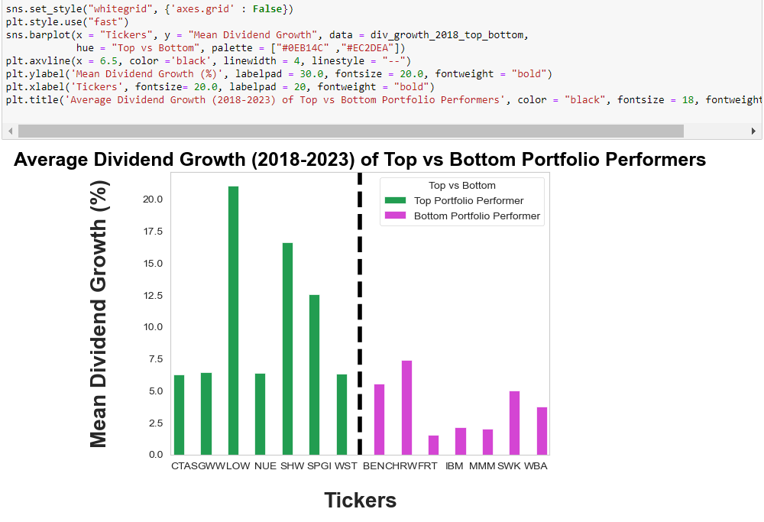


Comparing Growth Rates of Top vs Bottom Performers

Slide 22
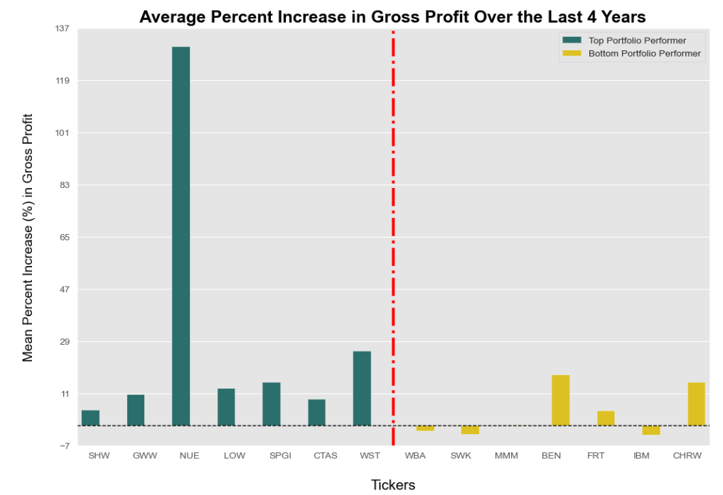
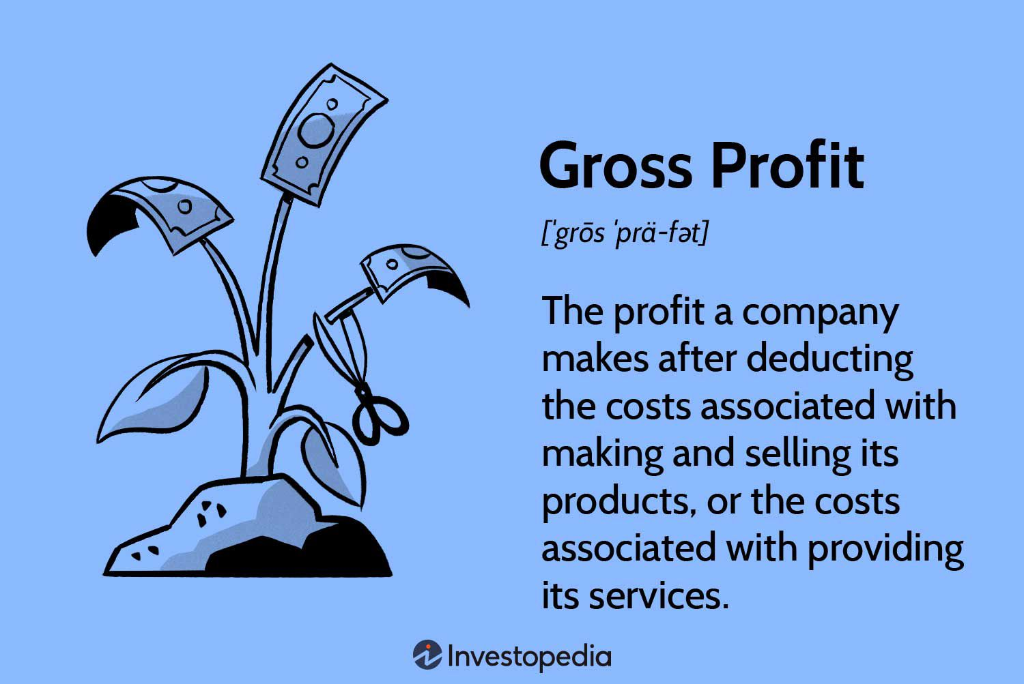
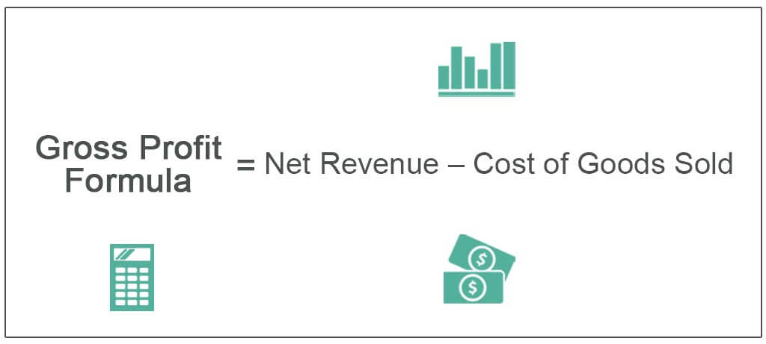
Average Increase in Gross Profit: (2019-2023)

Slide 23
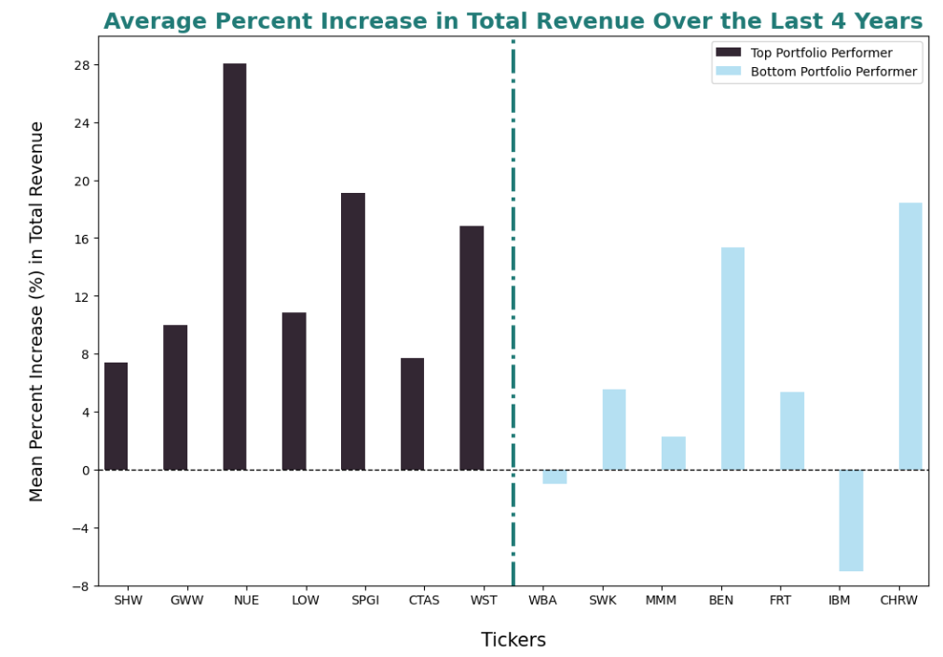
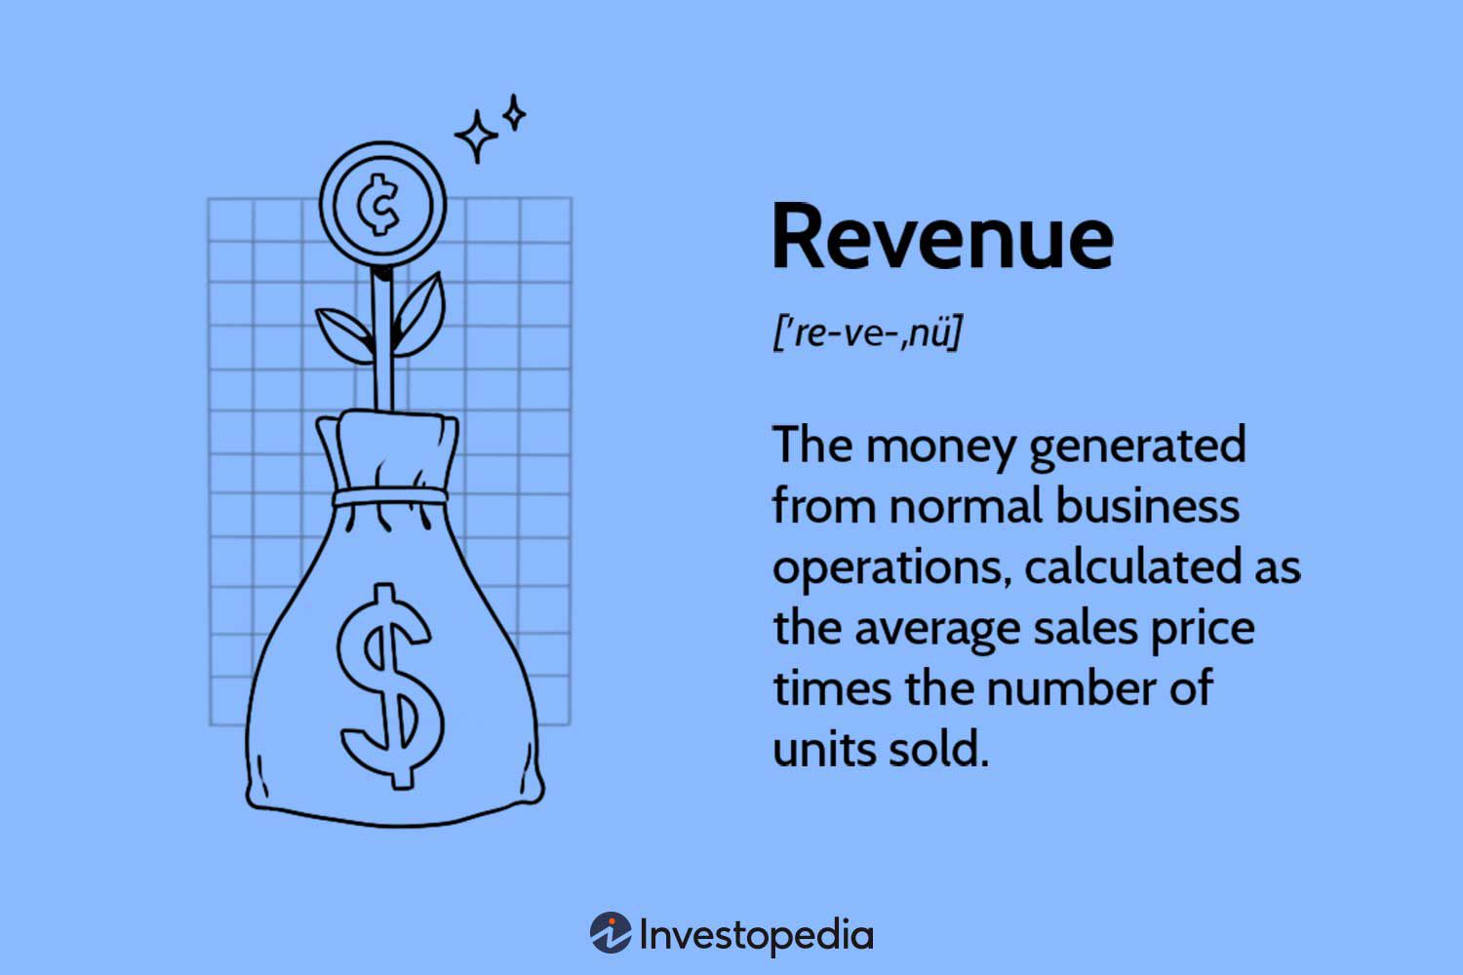
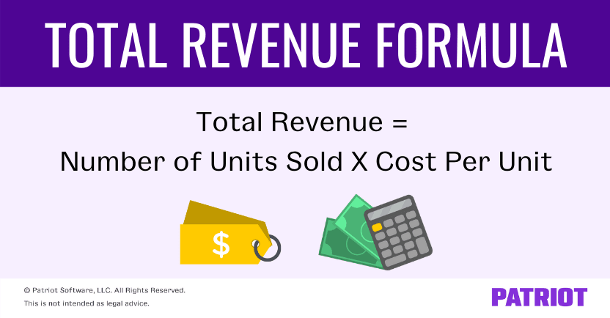
Average Increase in Total Revenue: (2019-2023)

Slide 24
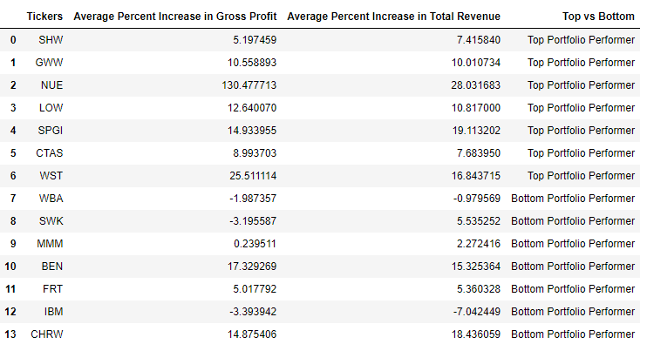
Remarks on Total Revenue and Gross Profit
Five of the Top 7 Performing Stocks had an annual percent increase in Total Revenue be 7% or greater.
Whereas only two of the Bottom 7 Performing Stocks had an annual percent increase in Total Revenue be at least 7%.
None of the 7 Best Performing Stocks had their average 4 year Gross Profit or Total Revenue be Negative (< 0%).
The best performing stocks generate consistent sales over long periods of time (for at least two years or more). The market rewards companies that have stable profits and show constant demand for their product (their sales continue to go up)!

Slide 25
Conclusion
Consumer Staples do NOT perform nearly as well as Consumer Discretionary Dividend Aristocrats.
Despite being theoretically more sensitive to economic changes, Consumer Discretionary companies have more upside potential than Consumer Staple Dividend Aristocrats; specifically they have more potential in the price increase of their stocks and in their annual increase in total revenue.
The top performing Dividend Aristocrats do not necessarily come from attention grabbing sectors like Technology and Health Care (most of the top performers in the portfolio ended up being “boring” companies I never really paid attention to, like Cintas Corp and Sherwin Williams.
On the other hand, famous companies like Coca-Cola, Pepsi, Walmart and IBM lagged behind in their performance.
The top performing Dividend Aristocrats don’t have very high dividend yields (they typically maintain a yield between the 2% - 3% range)
However, nearly all of the top performing Dividend Aristocrats showed large and consistent dividend growth rates (as high as 10% or more).
The top performing Dividend Aristocrats do not waver during unpredictable economic conditions. They continue to have strong performances in their annual Total Revenue and remain consistent with their increase of Gross Profits. The best stocks are “cash cows”.
In contrast, the worst performing Dividend Aristocrats tend to have decreasing Total Revenue and Gross Profits over a few years periods.

Slide 26
More Research to be done!!!
In my future research, I will:
Analyze the market cap of the best and worst performing Dividend Aristocrat stocks (see if there is any correlation between the size of the company and how well it performs over time)
Compare the Dividend Aristocrats to other stocks, such as Mutual Funds and Private Equity Stocks
Investigate the Free Cash Flow Per Share of all the Dividend Aristocrat stocks (I’ll need to use something more advanced than “yfinance” to be able to gather this kind of information)
Use a more detailed stock extractor tool to gather balance sheet information over decade long periods on the Dividend Aristocrats (not just 4 years worth of information)

